Slide 1
Accelerating Your OFFER
-- Machine Learning Practice to Speed Up Application Process
Siyuan Bai, Nan Liao, Lichen Kuai, Bingle Wu, Wenxiao Wu

Slide 2
Data Preprocessing--Cleaning
Sample Job Description
Company Name
"Company Overview\n\n\nAt Memorial Sloan Kettering (MSK), we’re not only changing the way we treat cancer, but also the way the world thinks about it. By working together and pushing forward with innovation and discovery, we’re driving excellence and improving outcomes. For the 28th year, MSK has been named a top hospital for cancer by U.S. News & World Report. We are proud to be on Becker’s Healthcare list as one of the 150 Great Places to Work in Healthcare in 2018, as well as one of Glassdoor’s Employees’ Choice Best Place to Work for 2018. We’re treating cancer, one patient at a time. Join us and make a difference every day.\n\nJob Description:
·······
\n\nYou will:\nSupport agile team in translating end user requirements into set of user product criteria for technical development team & developing documentation\nConnect with team to confirm product commitments\nConduct data analysis and research required for development team to make decisions\nCollaborate with team to understand, analyze, document, and communicate platform requirements\nPartner with key stakeholders to articulate and refine product vision throughout the iteration process\nHelp design team in translating product needs/requirements into deliverable units of work\nAble to synthesize metrics such as: user satisfaction/adoption, quality of products delivered, time-to-market, timely delivery etc···
Job Title (JT)
Normalizing JT into 4 Categories:
Business Analyst
Data Analyst
Data Scientist
Data Engineer
Job Description (JD)
Removing Unnecessary Words/ Sentences
Sentence with Company Name
Stopwords (nltk)
Line/ Tab Characters
Symbols
Data Preprocessing
LDA Model
Random Forest
Application
Validation

Slide 3
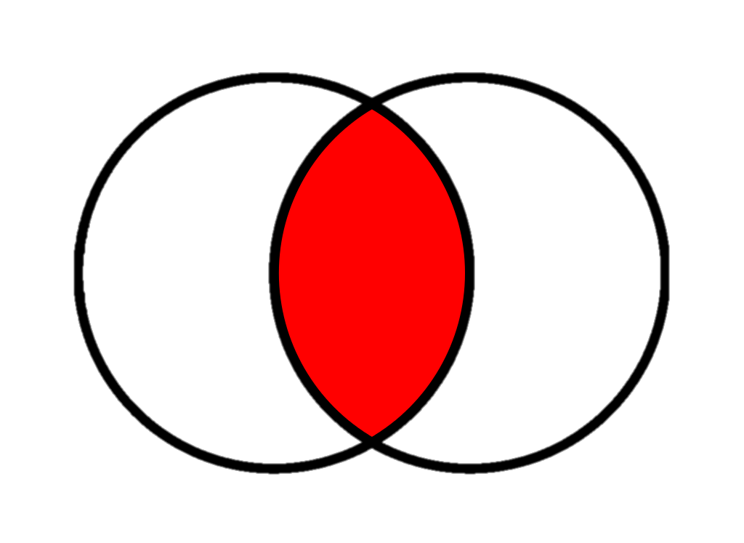
Data Preprocessing– Feature Mapping
A Set of Words that contains all the Technical Skills and Tools for Data Related Jobs
tool_keywords = set(['python', 'pytorch', 'sql', 'mxnet', 'mlflow', 'einstein', 'theano', 'pyspark', 'solr', 'mahout',
'cassandra', 'aws', 'powerpoint', 'spark', 'pig', 'sas', 'java', 'nosql', 'docker', 'salesforce', 'scala', 'r',
'c', 'c++', 'net', 'tableau', 'pandas', 'scikitlearn', 'sklearn', 'matlab','keras', 'tensorflow', 'clojure’,…])
skill_keywords = set(['statistics', 'chatbot', 'cleaning', 'blockchain', 'causality', 'correlation', 'bandit', 'anomaly', 'kpi',
'dashboard', 'geospatial', 'ocr', 'econometrics', 'pca', 'gis', 'svm', 'svd', 'tuning', 'hyperparameter', 'hypothesis',
'salesforcecom', 'segmentation', 'biostatistics', 'unsupervised', 'supervised’,…])
Stem Words within the Sets
Intersect Two Set to Obtain a Vector of Feature for Each of the Company
Tokenize the Words within the String then Stem Each Word
Job Description
Data Preprocessing
LDA Model
Random Forest
Application
Validation

Slide 4
LDA Model– Feature Mapping II
Input of the Models
Expected Output
For each of the Job Title
For each of the Job Title
Topic 1:
Job Description (JD)
10 Words with their Probabilities
Tokenize the JD & Count Each Word’s Frequency
LDA
Topic 2:
10 Words with their Probabilities
Remove the Top 500 Commonly Appeared Words
Topic 3:
Remove the Bottom 100 Commonly Appeared Words
10 Words with their Probabilities
Data Preprocessing
LDA Model
Random Forest
Application
Validation

Slide 5
LDA Model– Model Output
Business Analyst
'decision', 'medical', 'procurement', 'physical', 'collaboration', 'judgment', 'quantitative', 'operating', 'skillsstrong', 'party', 'input', 'feedback', 'common'…
LDA_DA +
LDA_DE
LDA_BA +
LDA_DS +
Data Analyst
LDA_List
'accuracyadept', 'reportsdevelop', 'setsfilter', 'qualityacquire', 'problemswork', 'bull', 'analyststrong', 'needslocate', 'opportunities', 'flow', 'clearance'…
Mapping for each of the Company Job Title to Obtain a New Vector
+
Data Scientist
'statistical', 'machine', 'learning', 'analytic', 'scientist‘, 'predictive', 'techniques', 'algorithms', 'visualization', 'machine', 'statistical', 'quantitative', 'techniques', 'programming'…
Pervious Vector From the Research List
=
Data Engineer
Final Feature
'etl', 'python', 'pipelines', 'big', 'azure', 'engineer', 'aws', 'warehouse', 'bi', 'learning', 'big', 'hadoop', 'azure', 'spark', 'programming', 'python', 'streaming'…
Data Preprocessing
LDA Model
Random Forest
Application
Validation

Slide 6
Random Forest – Model Constructions
Data Preprocessing
LDA Model
Random Forest
Application
Validation

Slide 7
Random Forest – Model Output
Data Preprocessing
LDA Model
Random Forest
Application
Validation

Slide 8
Model Application
Data Preprocessing
LDA Model
Random Forest
Application
Validation

Slide 9
Validation
Data Preprocessing
LDA Model
Random Forest
Application
Validation

